Slide 1
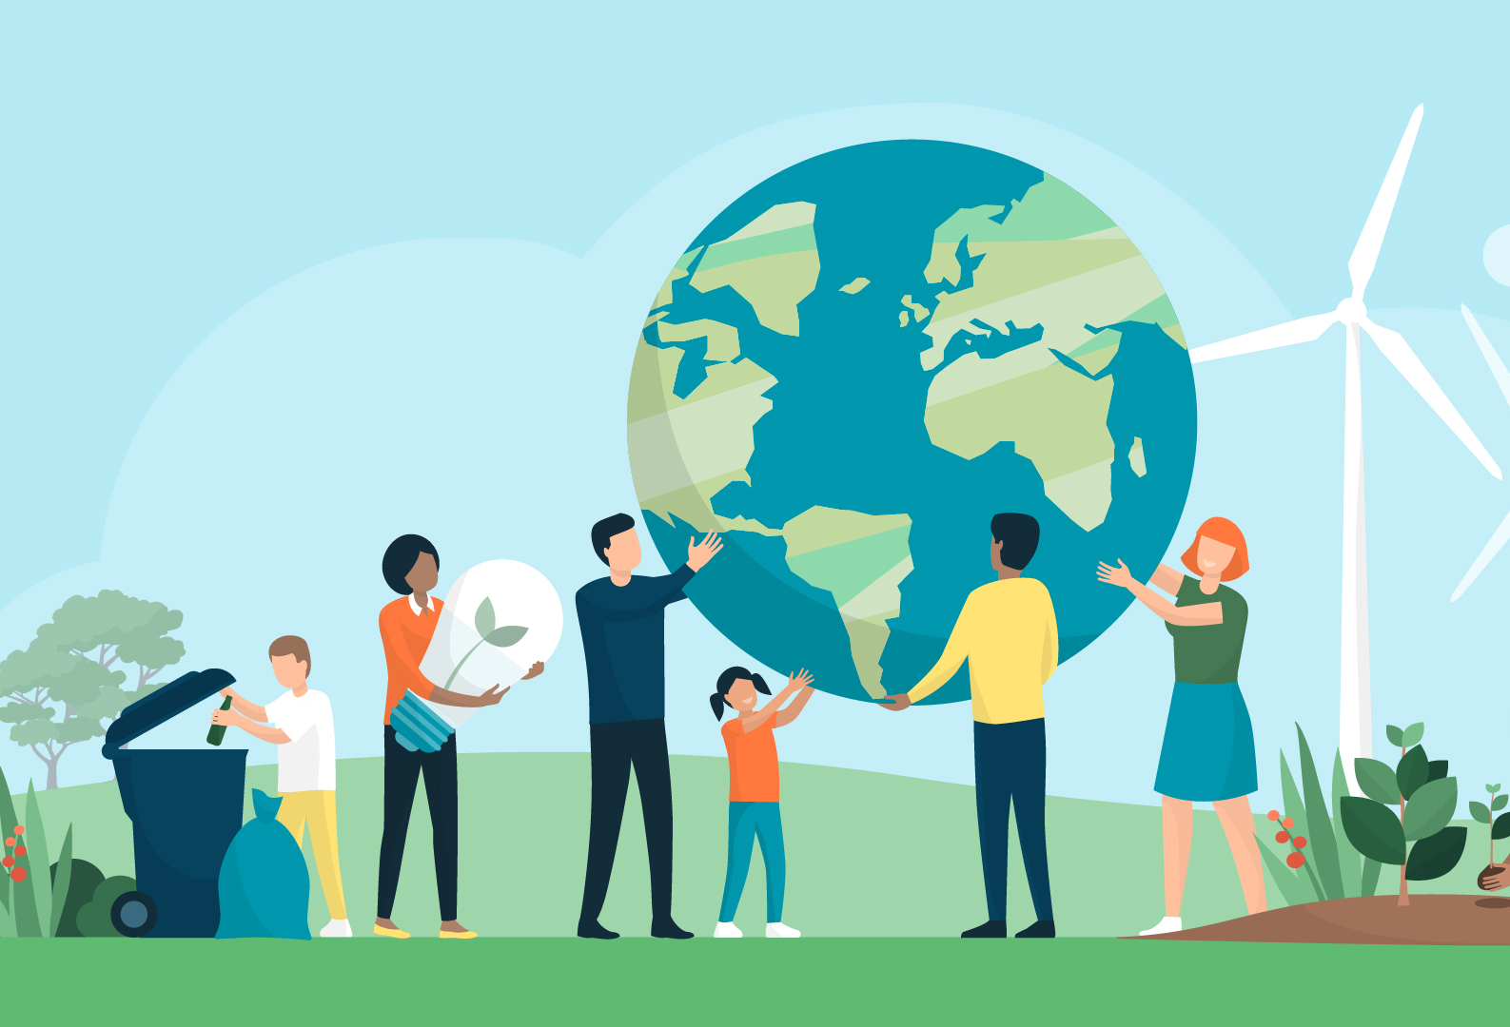
UNA Greater Lincolnshire
Sustainable Development and UN 2030 SDG’s
Clive Wilson
Bert Moore
unagreaterlincolnshire.org
#bethechange

Slide 2
1 Aims of the Session
To raise awareness of the challenges facing Local Parishes, Communities and Individuals in Lincolnshire, looking forward to 2030 ( and beyond)
To explore what is meant by ‘Sustainable Development’ and how this is represented in the United Nations Sustainable 2030 Development Goals
To introduce the ideas on ‘Doughnut Economics’ and ‘Circular Economy’
To learn about project support from Lincolnshire CC and share perspectives and practices from Lincolnshire Parishes with regard to Sustainable Development
To identify ways of working together to achieve ‘Sustainable’ Parishes and Communities
To identify support and training required for Parishes and their Councillors

Slide 3
2 Local Government and SDG’s
‘All of the Sustainable Development Goals (SDGs) have targets that are directly or indirectly related to the daily work of local and regional governments. Local governments should not be seen as mere implementers of the agenda. Local governments are policy makers, catalysts of change and the level of government best-placed to link the global goals with local communities.’ (Local Government Association 2020)
unagreaterlincolnshire.org
#bethechange

Slide 4
3 Starting Points.. Working in groups
What sort of things do you think will affect the wellbeing of individuals in your Parish / Community over the next 10 to 20 years
Consider: Children/Teenagers/ Parents / Retired / Private Businesses and Owners / Public Sector / and all employees
(Put each idea on a separate post it)
unagreaterlincolnshire.org
#bethechange

Slide 5
4 Sustainable Development
Sustainable development has been defined as development that meets the needs of the present without compromising the ability of future generations to meet their own needs.
Sustainable development calls for concerted efforts towards building an inclusive, sustainable and resilient future for people and planet.
For sustainable development to be achieved, it is crucial to harmonize three core elements: economic growth, social inclusion and environmental protection. These elements are interconnected and all are crucial for the well-being of individuals and societies.
unagreaterlincolnshire.org
#bethechange

Slide 6
5 UN 2030 Sustainable Development Goals Launched in 2015
There was a five year process of dialogue around the world starting in 2010 , particularly involving young g people, in shaping the 2030 SDG’s
On 1 January 2016, the 17 Sustainable Development Goals (SDGs) of the 2030 Agenda for Sustainable Development — adopted by world leaders in September 2015 at an historic UN Summit — officially came into force. Over the next fifteen years, with these new Goals that universally apply to all, countries will mobilize efforts to end all forms of poverty, fight inequalities and tackle climate change, while ensuring that no one is left behind.
Launch Video
https://www.youtube.com/watch?v=RpqVmvMCmp0
unagreaterlincolnshire.org
#bethechange

Slide 7
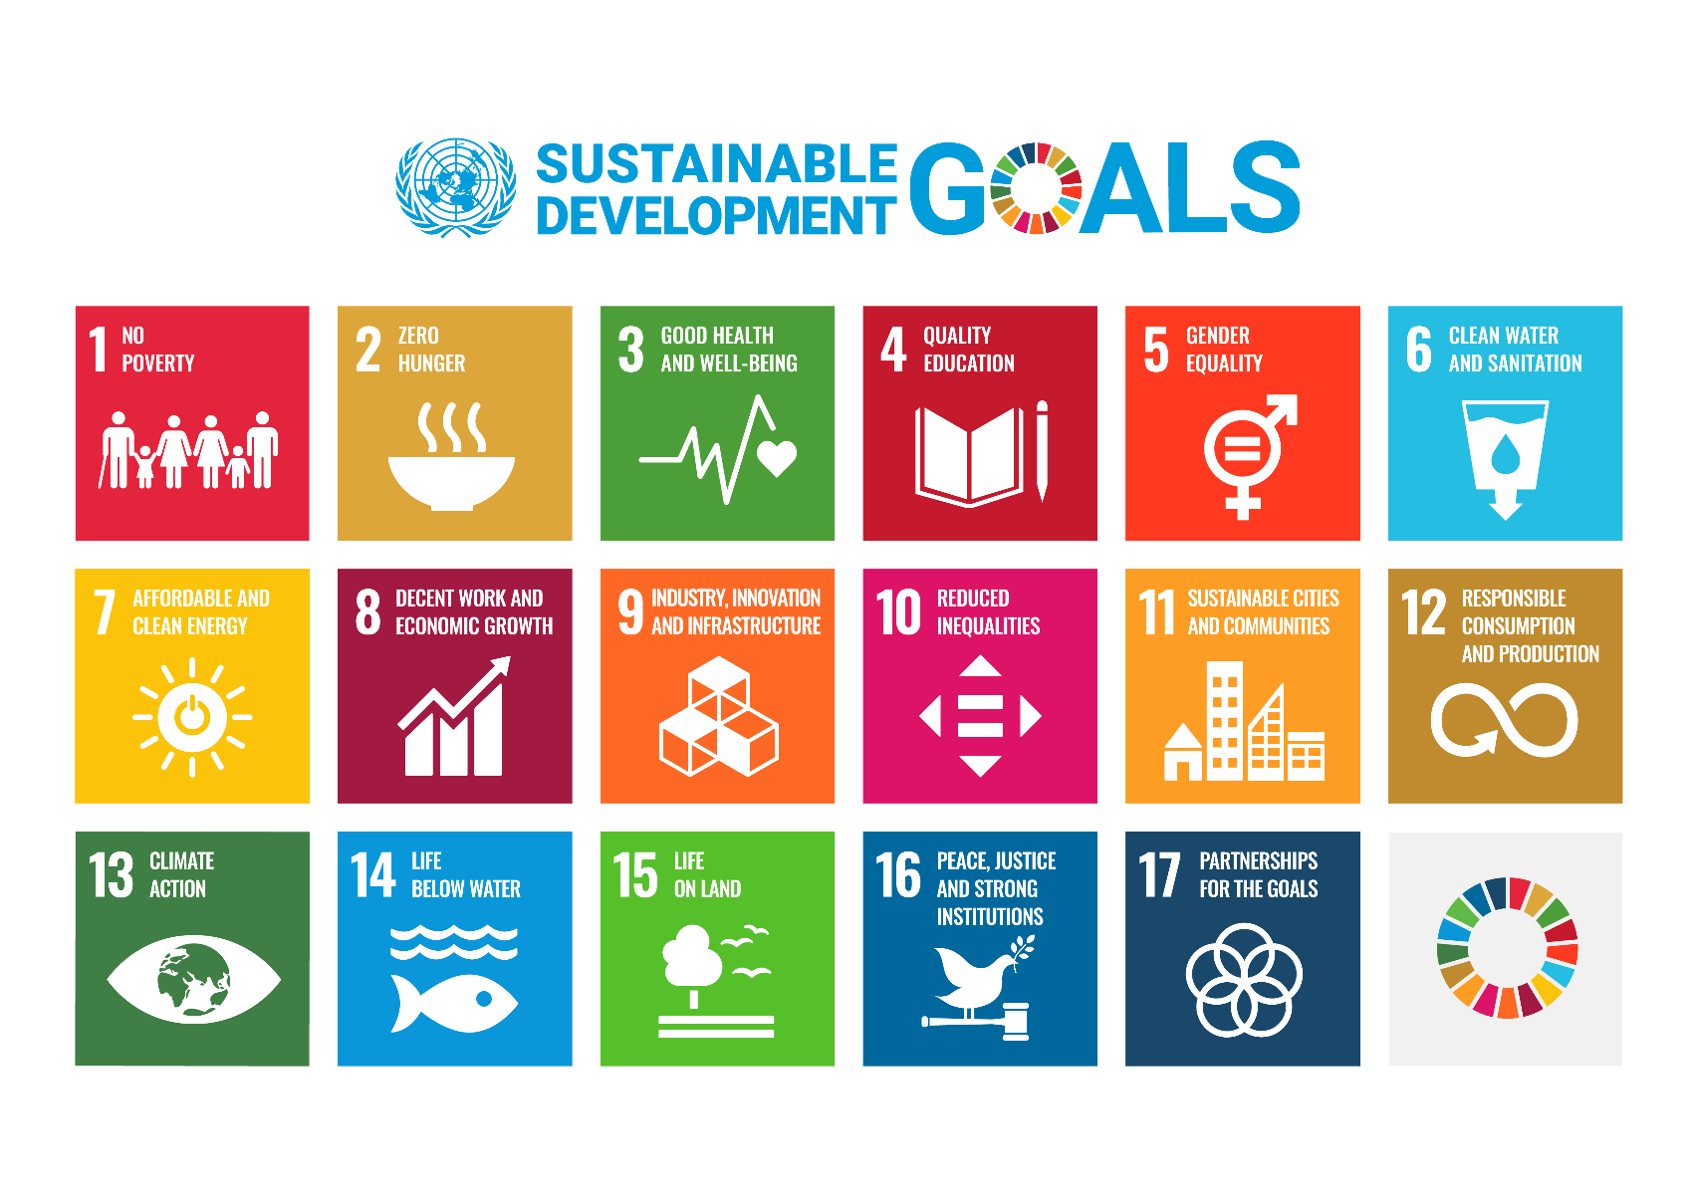
6 UN 2030 Sustainable Development Goals
https://www.un.org/sustainabledevelopment/
unagreaterlincolnshire.org
#bethechange

Slide 8
7 How do we see the future?
On the A4 piece of paper: Draw a picture of ‘the future’
– as you see it
When finished stick on the wall – then its comfort break time!
unagreaterlincolnshire.org
#bethechange

Slide 9
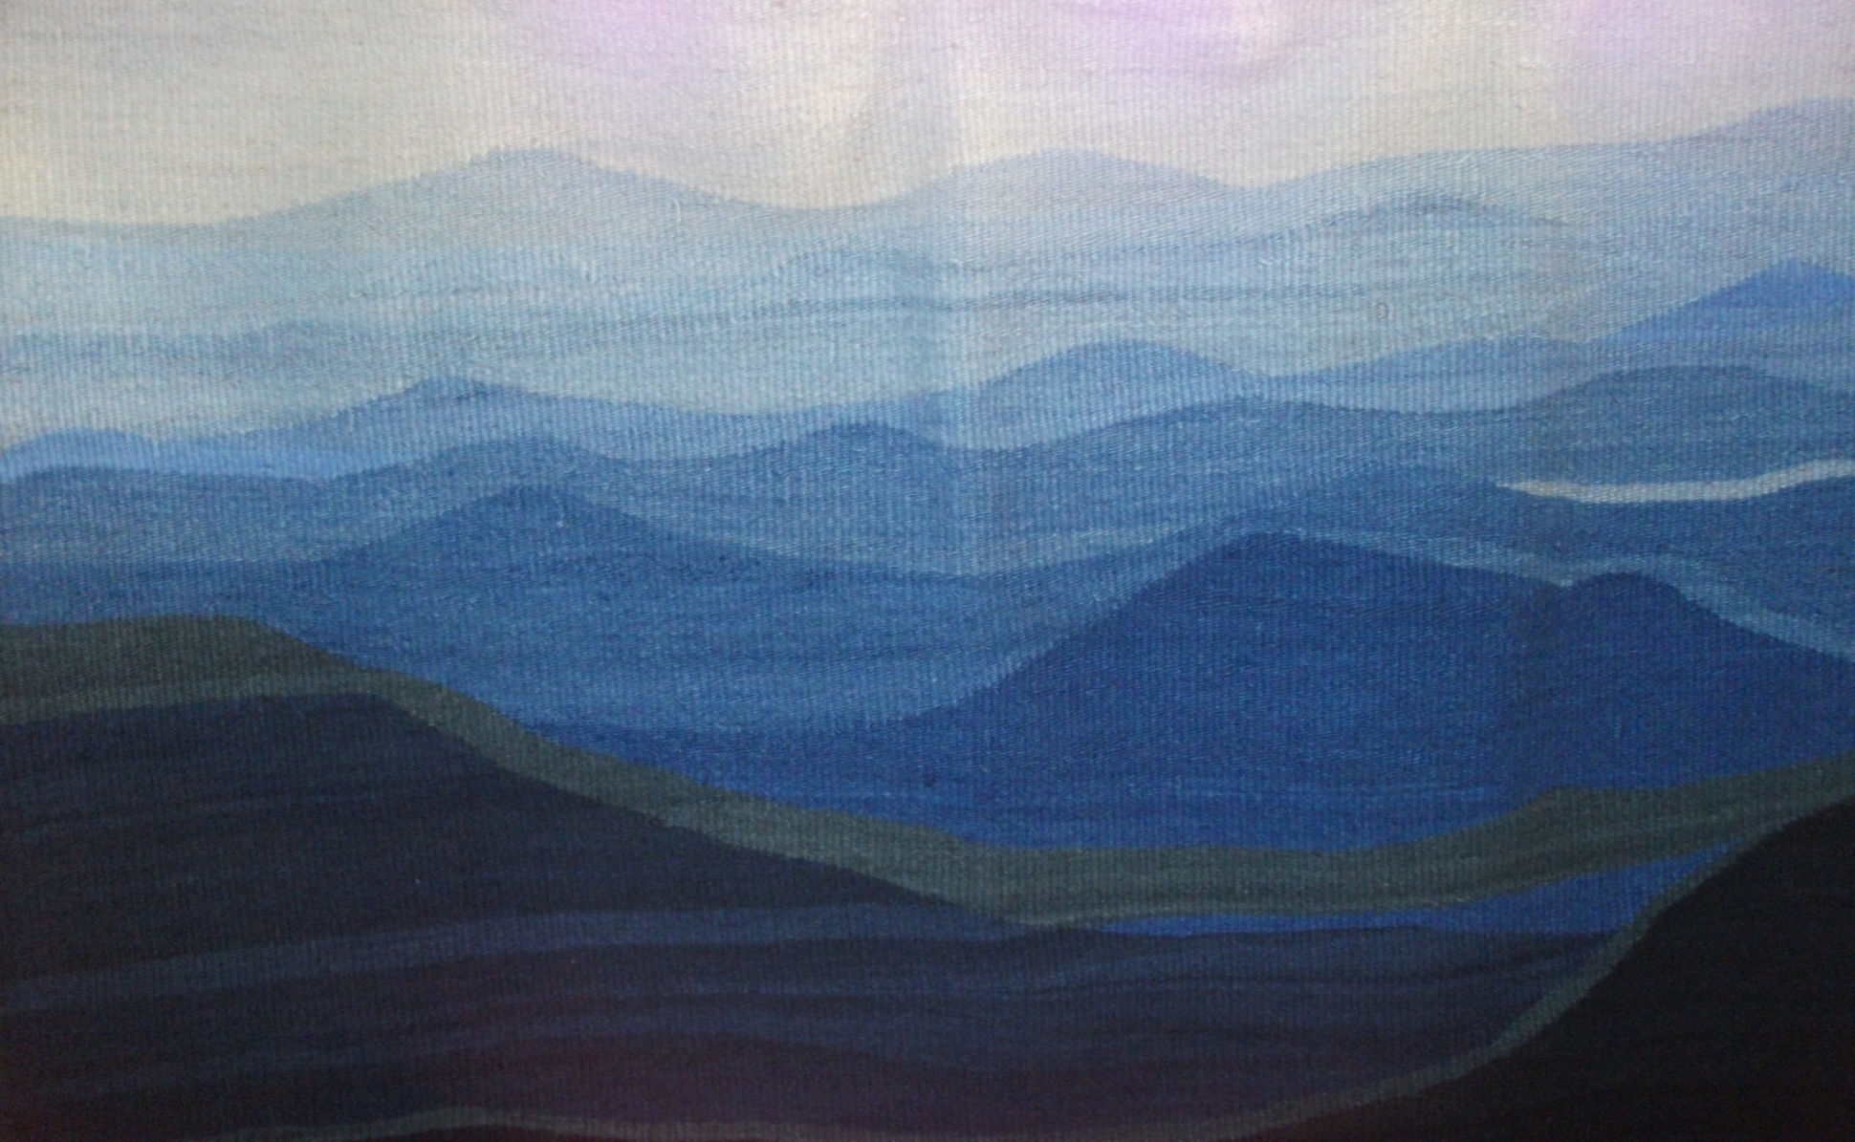
Time for a quick comfort break
unagreaterlincolnshire.org
#bethechange

Slide 10
8 Doughnut Economics (Kate Rawarth) An alternate way of viewing our economic decision making to include the environmental and social impact of the decision.
unagreaterlincolnshire.org
#bethechange

Slide 11
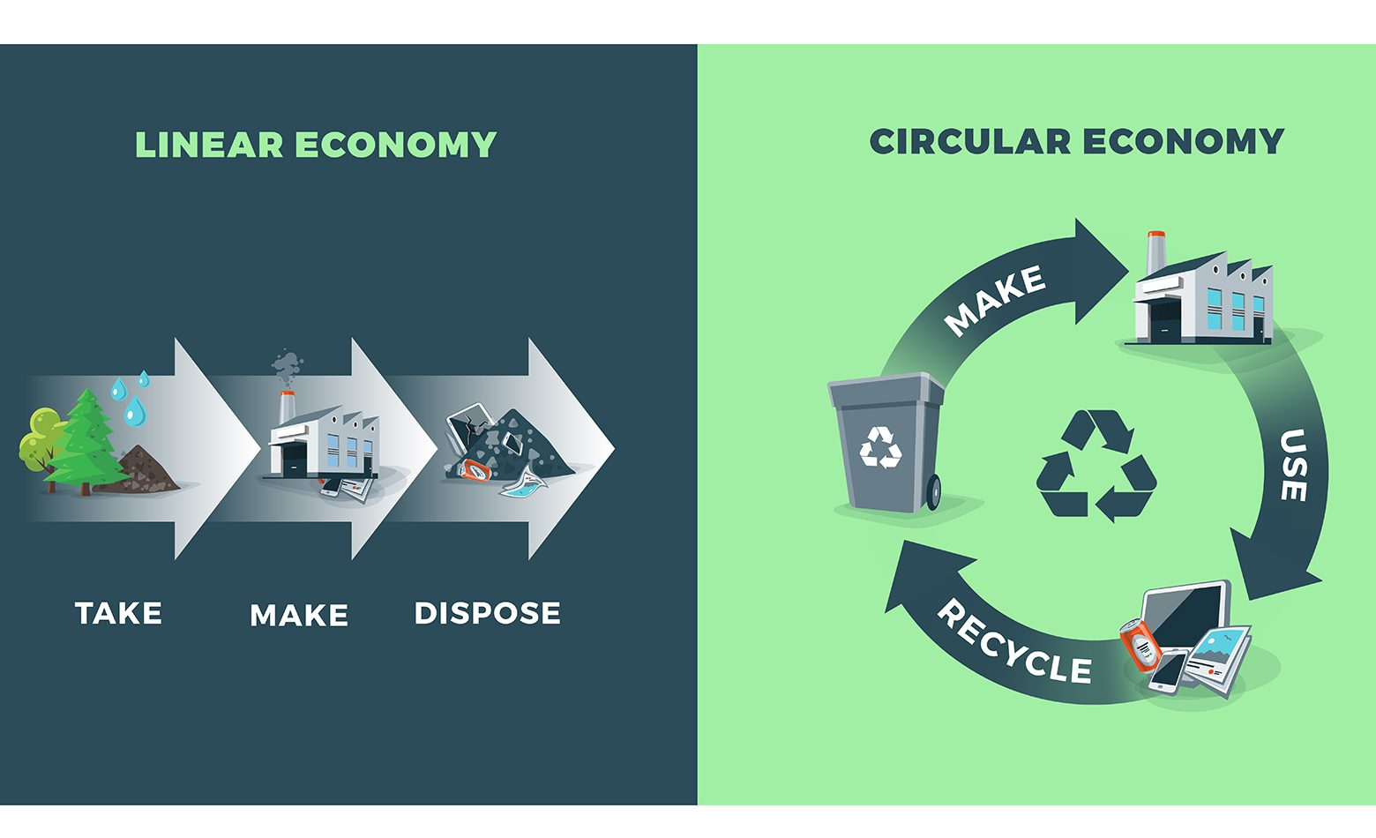
9 Linear v Circular Economy
unagreaterlincolnshire.org
#bethechange

Slide 12
10 Circular Economy
unagreaterlincolnshire.org
#bethechange

Slide 13
11 Circular Economy (Ellen McArthur Foundation)
The circular economy is based on three principles, driven by design:
Eliminate waste and pollution
Circulate products and materials (at their highest value)
Regenerate nature
It is underpinned by a transition to renewable energy and materials. A circular economy decouples economic activity from the consumption of finite resources. It is a resilient system that is good for business, people and the environment.
unagreaterlincolnshire.org
#bethechange

Slide 14
12 Local Projects and Support
Dan Clayton Lincs CC
Lincolnshire CC initiatives and Support
Are there things that you are currently doing in your parishes with regard to sustainability, is there more you could do together?
unagreaterlincolnshire.org
#bethechange

Slide 15
Zero Carbon Parishes
Engaging Rural Communities on Carbon Reductions

Slide 16
Net Zero – Rural Challenges
2050 target for net zero across the whole economy of the county
The County Council has made good progress with reducing its own emissions (c70%) – but emissions in wider economy have fallen at a slower rate (c40%)
GHG emissions are in general higher in rural than in urban areas
Lincolnshire has specific greenhouse gas challenges around housing, agriculture and transport
Climate engagement examples tend to be from urban areas – such as Leeds Climate Commission

Slide 18
Zero Carbon Parishes Project
Wanted to engage with rural communities on climate change issues – especially around housing and transport as part of our Lincolnshire Green Masterplan
Small amount of funding to deliver small scale local environmental projects
IMPACT Tool – developed by Centre for Sustainable Energy, University of Exeter and Midlands Net Zero Hub
IMPACT Tool used as a way to get a local conversation going on what they could do locally to tackle climate change

Slide 19
IMPACT Tool
Impact is an estimator of a community’s carbon footprint that works for parishes wards, district councils and unitary authorities.
It draws on more than 30 datasets to estimate the total amount of greenhouse gases produced directly and indirectly in the given locality - heating homes, using electricity, transport, producing and distributing food, disposing of waste, etc.
Impact has been designed to help you and your community to access, analyse and act on your community’s carbon footprint and to give you a better idea of where to target your efforts for the greatest impact in tackling the climate emergency.

Slide 20
IMPACT – Consumption / Territorial
Consumption-based carbon footprint - This shows the emissions produced as a result of what people within your parish, ward or council area use in their daily lives. This includes the obvious things like gas, electricity and petrol, but also products like food and drink, clothes, shoes, consumer electronics and appliances, as well as financial services, even where these emissions take place outside of the local area.
Territorial-based carbon footprint - This shows the emissions produced within the territorial boundaries of your parish, ward or council area, and is based on what happens in that space. So this includes emissions from the presence of roads or other transport systems, or local agriculture and manufacturing, whether or not local people were travelling on that road or use those products and services.

Slide 21
IMPACT - Website
https://impact-tool.org.uk/
Caythorpe – South Kesteven example

Slide 22
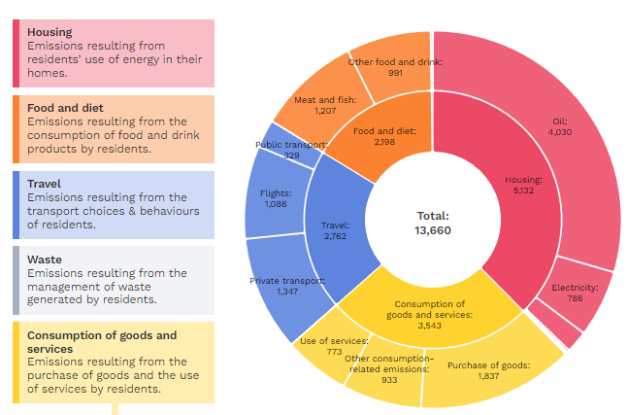
Consumption Based Information

Slide 23
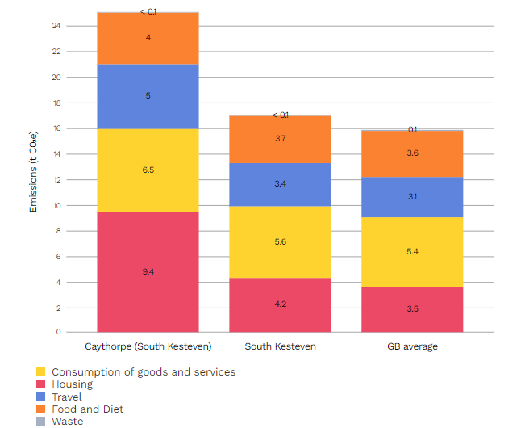

Slide 24
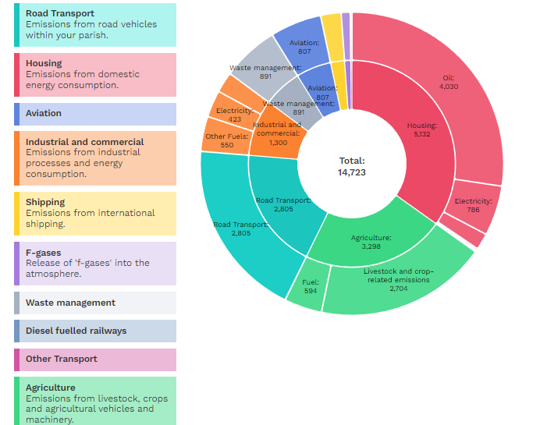
Territorial Based Information

Slide 25
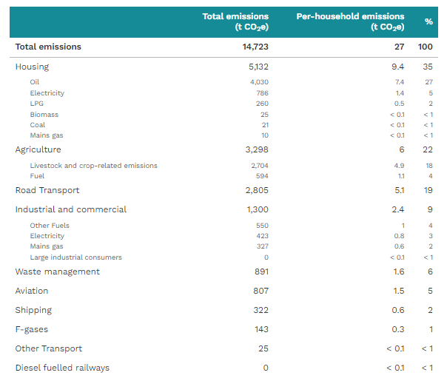

Slide 26
Zero Carbon Parishes - Lincolnshire
Promoted the scheme through the Parish and Town Council newsletter – which goes out to every parish and town council around the county
Gave each parish council that took part in the scheme the IMPACT Tool link and the report on their parish
Offered to support projects with projects up to a value of £5,000

Slide 27
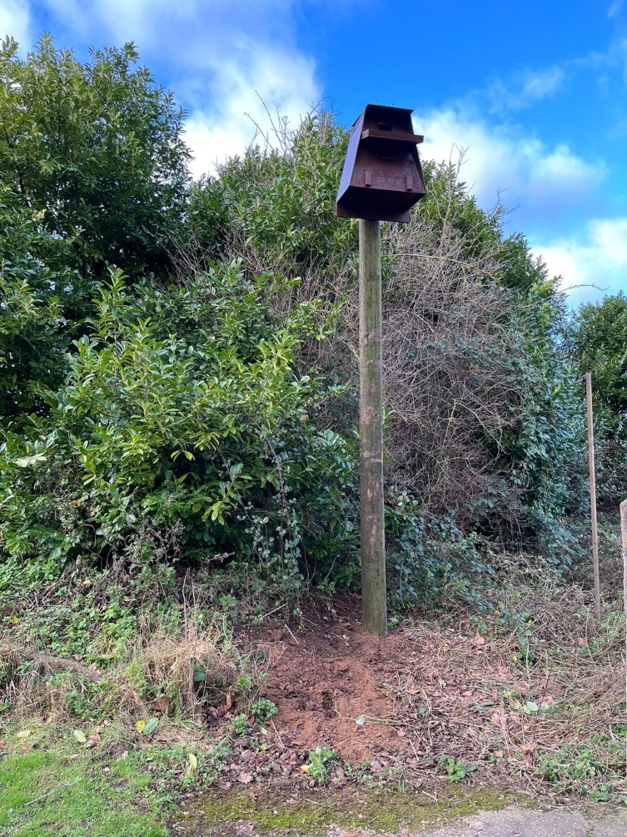
Holbeach
Water fountain – Holbeach water bottles
Cycle repair scheme
LED lighting at Reading Rooms
Owl boxes

Slide 28
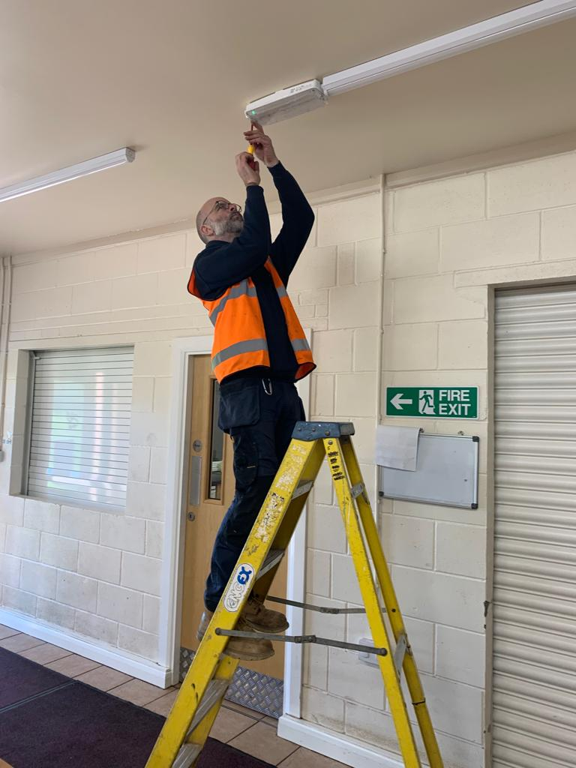
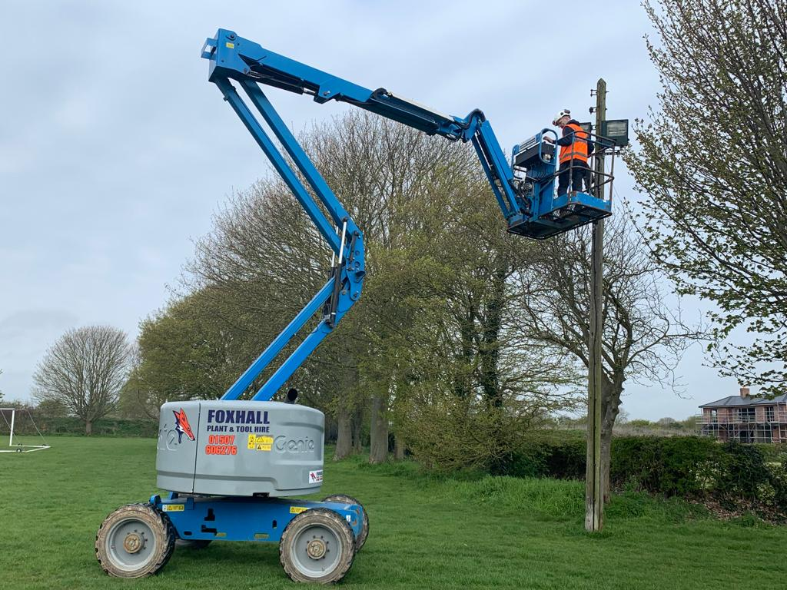
North Somercotes
LED lighting of Sports Pavilion and floodlights

Slide 29
Nettleham
Developed a neighbourhood plan for the village
This led on to a Climate Action Plan for Nettleham and a Climate Change Working Group
The Parish Council was already working on Climate Change related projects – so were able to incorporate Zero Carbon Parishes into their existing plans

Slide 30
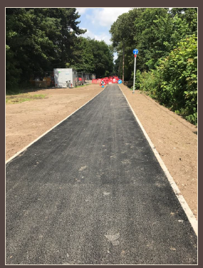
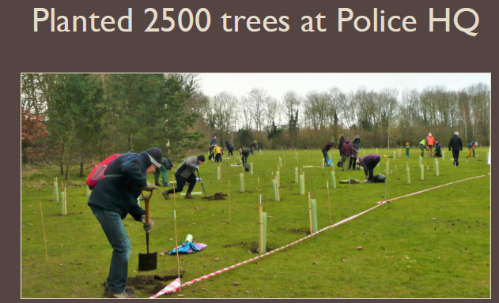
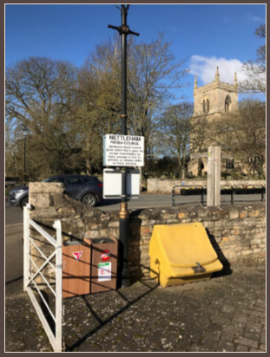
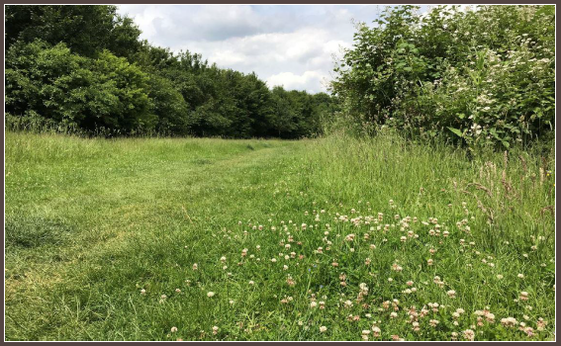

Slide 31
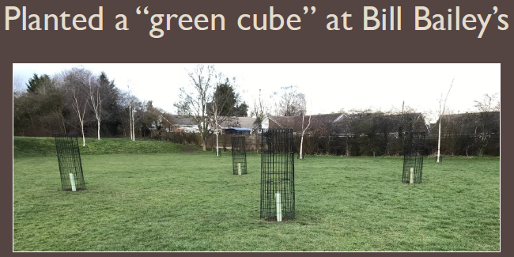
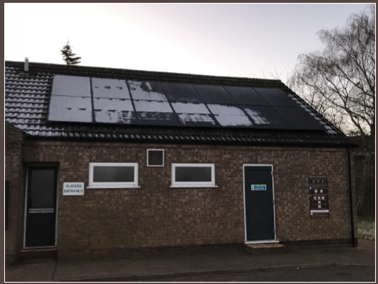
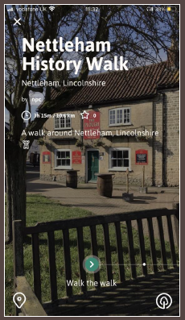
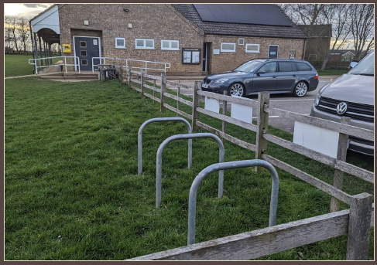

Slide 32
Next Steps
Phase One – will work with 15 parishes around the county
Energy price rises have meant that much of the work has been focussed on energy efficiency in parish council buildings – village halls, pavilions, etc.
Aiming to deliver a phase two to the project building on the lessons from the initial projects
Will look to develop housing and transport based projects – linking into other projects such as LEVI and active travel
Looking to get more community involvement – planting schemes and thermal imaging camera for residents

Slide 33
13 The Challenge
If your great grandchildren in 2060 were looking at the Parish minutes from now to 2030
What do you think there will be in the Parish Minutes regarding sustainability
unagreaterlincolnshire.org
#bethechange

Slide 34
14 The Challenge
“if not you then who, if not now then when?”
and
‘If not you who can .. then who will?’
unagreaterlincolnshire.org
#bethechange

Slide 35
Thankyou
unagreaterlincolnshire.org

