Slide 1


UNA Greater Lincolnshire
Introductory Presentation
unagreaterlincolnshire.org
#bethechange

Slide 2

Agenda
Introductions: Clive Wilson, Chair UNA Greater Lincolnshire
Background to UNAGL https://www.unagreaterlincolnshire.org/
Purpose(s) of UNA GL
UN 2030 Sustainable Development Goals
Business and Sustainable Development
Invitations to get involved in new thinking and actions
Q&A Session
Conclusions and thanks

Slide 3
Introduction Sustainable Development
Meeting present needs, without compromising future generations, balancing economic growth, environmental protection and social inclusion

Slide 4
UNA Greater Lincolnshire Background & Purpose
The ‘So What’ Question: £GDP and Sustainable Development
Conversations with Business, Education and Community
Thinking about your grandchildren's grandchildren
Thinking about all grandchildren's grandchildren everywhere
UNA GL Formed in October 2020
NEW THINKING AND ACTION TO PROMOTE THE ATTAINMENT OF THE 2030 UN SUSTAINABLE DEVELOPMENT GOALS
unagreaterlincolnshire.org
#bethechange

Slide 5
The Challenge to Ourselves
“if not you then who, if not now then when”
unagreaterlincolnshire.org
#bethechange

Slide 6
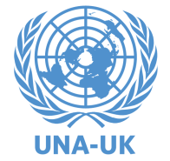
Life Decisional Roles
Consumer
Consumer, Producer
and Citizen
Citizen
Producer
unagreaterlincolnshire.org
#bethechange

Slide 7
Life Engagement Roles
Education
Business, Education
and Community
Community
Business
unagreaterlincolnshire.org
#bethechange

Slide 8


Why UNA Greater Lincolnshire?
unagreaterlincolnshire.org
#bethechange

Slide 9

UN 2030 Sustainable Development Goals
Adopted by all UN Nation States in 2015
unagreaterlincolnshire.org
#bethechange

Slide 10
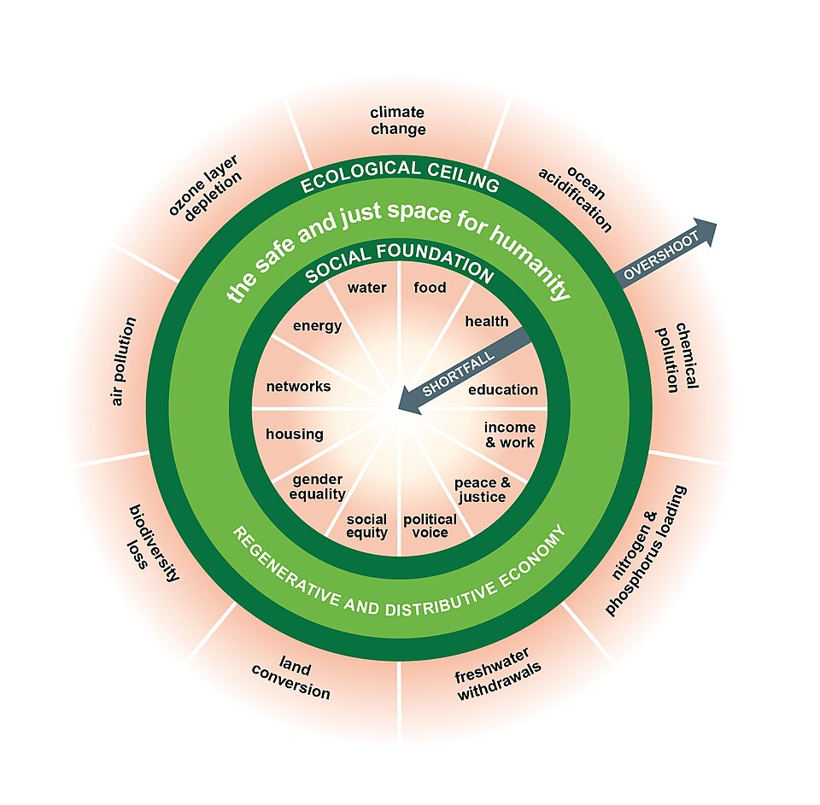
Doughnut Economics
Kate Rowarth
  Eg:
  Herring Farm
  Walesby
  Regenerative Farming
  ‘Despite all our accomplishments we owe our existence to a six-inch layer of topsoil and the fact it rains’
unagreaterlincolnshire.org
#bethechange

Slide 11
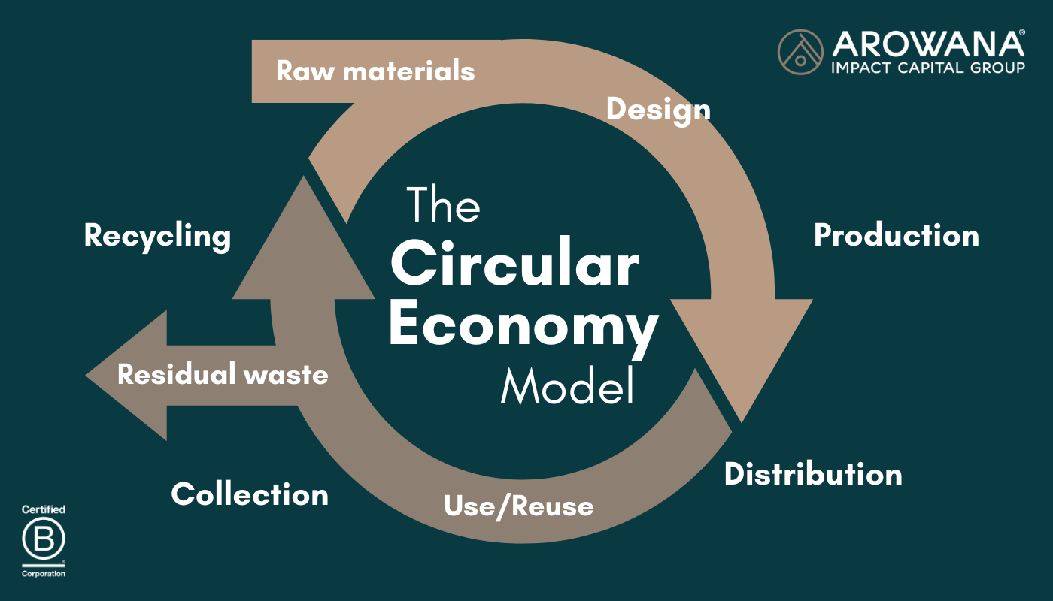
Circular Economy do not design for waste
  Eg:
  BGB Innovation Ltd Grantham
  ‘Alongside our partners, reduce waste in everything we do’
  Protect the Environment
unagreaterlincolnshire.org
#bethechange

Slide 12
Sustainable Development and Standards
Meeting present needs without compromising future generations, balancing economic growth, environmental protection and social inclusion
SDG: UN 2030 Sustainable Development Goals
ESG: Environmental Social and Governance Standards
BNG: Biodiversity Net Gain
ISO 14001: Environmental Management Systems

Slide 13
Smaller businesses and Sustainable Development
Business
Get ahead of Future Law
Attract Investors, meet ESG obligations
Build trust with customers and supply chain
Manage risks, Profit and Loss and Balance Sheet
Climate Adaptation and Mitigation, manage future Costs
Retain Talented Workforce
Seize opportunities …
Or BAU… Business as Usual
unagreaterlincolnshire.org
#bethechange

Slide 14
Introduction
Our Challenge
“if not you then who, if not now then when”
unagreaterlincolnshire.org
#bethechange

Slide 15
Thankyou
unagreaterlincolnshire.org

Slide 16
unagreaterlincolnshire.org
#bethechange

