Slide 1
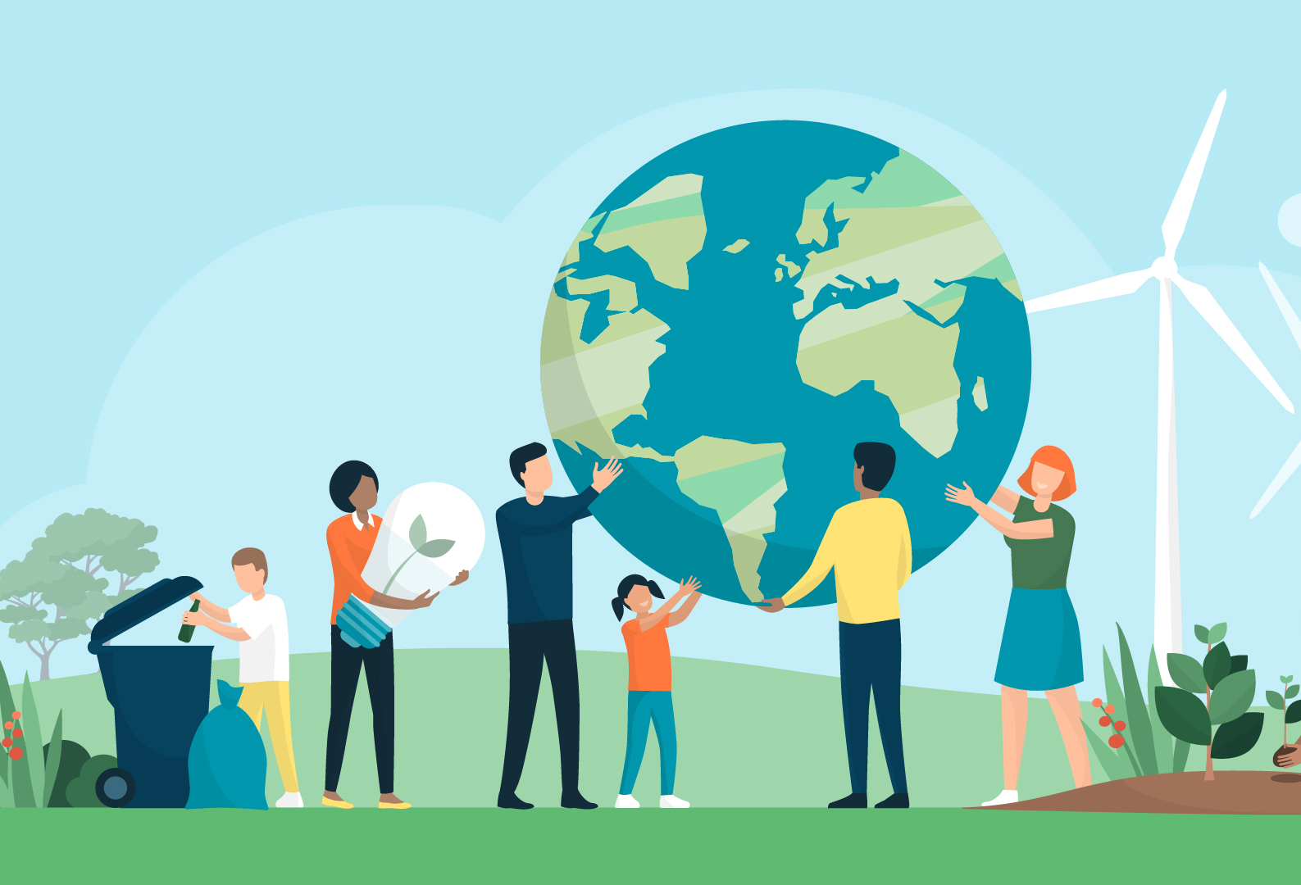

UNA Greater Lincolnshire
‘Sustainable Development
.. Or ... What can we do to save the planet for ourselves and future generations’
UNA GL
unagreaterlincolnshire.org
#bethechange

Slide 2

The Challenge
“if not you then who, if not now then when?”
and
‘If not you who can .. then who will?’
unagreaterlincolnshire.org
#bethechange

Slide 3
Aims of the Session
To raise awareness and recognise challenges facing Individuals and Communities , Locally, Nationally and Internationally looking forward to 2030 (and beyond)
To explore what is meant by ‘Sustainable Development’ and how this is represented in the United Nations Sustainable 2030 Development Goals
To introduce the ideas on ‘Doughnut Economics’ and ‘Circular Economy’
To offer the opportunity to join a next steps ‘intergenerational’ learning project

Slide 4
Starting Points..
  What sort of things do you think will affect the wellbeing of you, your family, your community over the next 10 to 20 years
  Consider: Children/Teenagers/ Parents / Retired / Private Businesses and Owners / Public Sector / and all employees
unagreaterlincolnshire.org
#bethechange

Slide 5
Sustainable Development 1
Sustainable development has been defined as development that meets the needs of the present without compromising the ability of future generations to meet their own needs.
Sustainable development calls for concerted efforts towards building an inclusive, sustainable and resilient future for people and planet.
unagreaterlincolnshire.org
#bethechange

Slide 6
Sustainable Development 2
For sustainable development to be achieved, it is crucial to harmonize three core elements: economic growth, social inclusion and environmental protection.
These elements are interconnected and all are crucial for the well-being of individuals and societies and all living things.
unagreaterlincolnshire.org
#bethechange

Slide 7
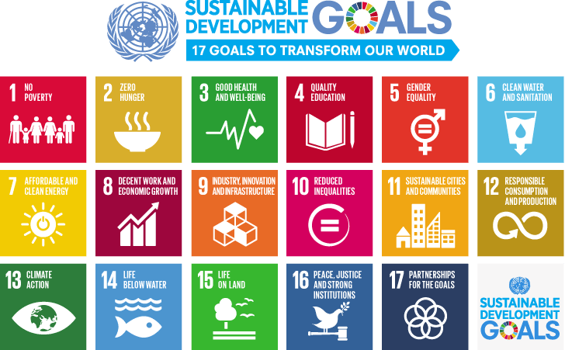
unagreaterlincolnshire.org
#bethechange

Slide 8
UN 2030 Sustainable Development Goals
Launched in 2015
A five year process of dialogue around the world starting in 2010 , particularly involving young people, in shaping the 2030 SDG’s
On 1 January 2016, the 17 Sustainable Development Goals (SDGs) of the 2030 Agenda for Sustainable Development — adopted by world leaders in September 2015 at an historic UN Summit — officially came into force.
Over the next fifteen years, with these new Goals that universally apply to all, countries will mobilize efforts to end all forms of poverty, fight inequalities and tackle climate change, while ensuring that no one is left behind.
Launch Video
https://youtu.be/RpqVmvMCmp0 https://www.youtube.com/watch?v=sk45zFk62QU ( English Sub Titles)
unagreaterlincolnshire.org
#bethechange

Slide 9
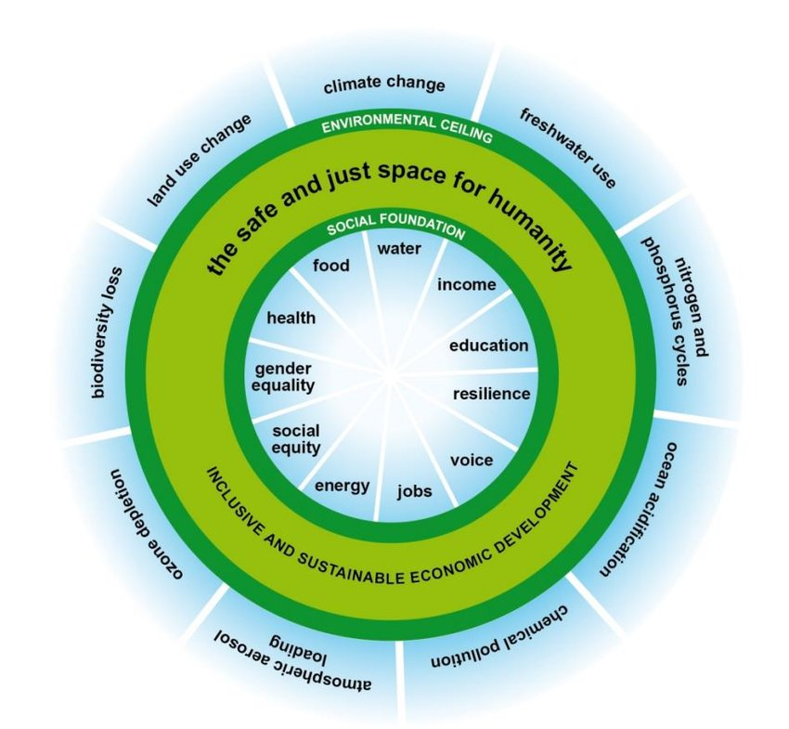
Doughnut Economics
(Kate Rawarth)
An alternate way of viewing our economic decision making to include the environmental and social impact of the decision.
unagreaterlincolnshire.org
#bethechange

Slide 10
Facing immediate challenges
  Mitigation
  Adaptation
unagreaterlincolnshire.org
#bethechange

Slide 11
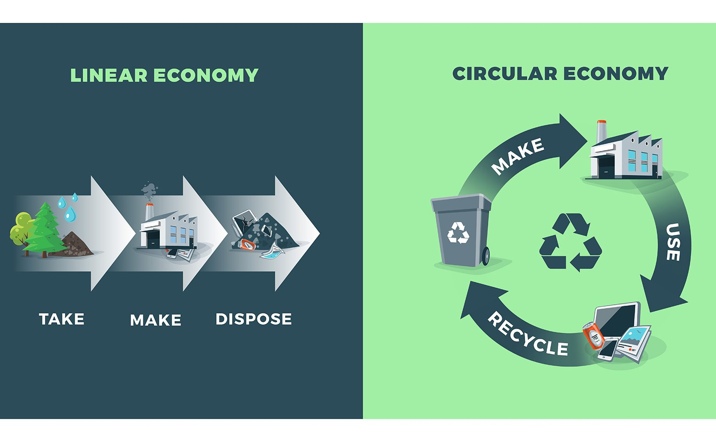
Linear v Circular Economy
unagreaterlincolnshire.org
#bethechange

Slide 12
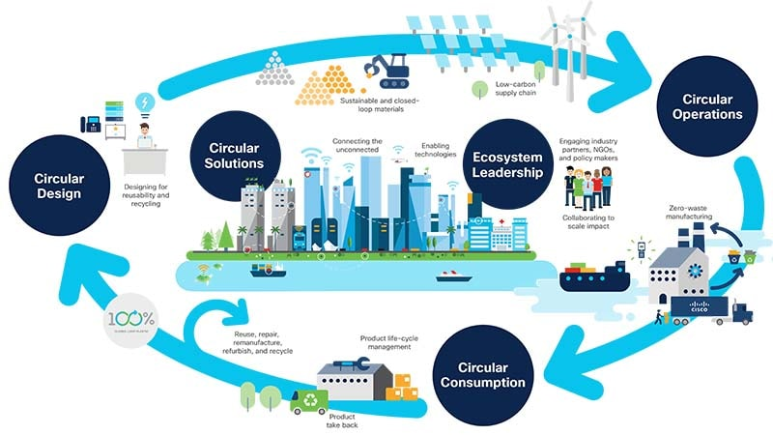
Circular Economy
unagreaterlincolnshire.org
#bethechange

Slide 13
Circular Economy (Ellen McArthur Foundation)
The circular economy is based on three principles, driven by design:
Eliminate waste and pollution
Circulate products and materials (at their highest value)
Regenerate nature
It is underpinned by a transition to renewable energy and materials. A circular economy decouples economic activity from the consumption of finite resources. It is a resilient system that is good for business, people and the environment.
unagreaterlincolnshire.org
#bethechange

Slide 14
Consider your life roles and influence
  Consumer ( Home, rest and play)
  Producer ( At work )
  Citizen ( Parish/Town/UK/World)
We can all be a Trojan Mouse!
unagreaterlincolnshire.org
#bethechange

Slide 15
A Challenge we give to all organisations that have public accountability...
  If your great grandchildren in the future were looking at the minutes of meetings
  for 2025 to 2030
  What do you think there will be in the Minutes regarding action on sustainability and sustainable development?
unagreaterlincolnshire.org
#bethechange

Slide 16
My World Our World
  The opportunity to engage in an intergenerational project with UNA Greater Lincolnshire
  https://www.unagreaterlincolnshire.org/projects-news/my-world-our-world-2030/
  # be the change!
unagreaterlincolnshire.org
#bethechange

Slide 17
The Challenge
“if not you then who, if not now then when?”
and
‘If not you who can .. then who will?’
unagreaterlincolnshire.org
#bethechange

Slide 18
Thankyou
unagreaterlincolnshire.org

