Slide 1


UNA Greater Lincolnshire
U3A January 2026
Progress, Change
and Challenge
unagreaterlincolnshire.org
#bethechange

Slide 2

Introduction
Our Background
“if not you then who, if not now then when”
unagreaterlincolnshire.org
#bethechange

Slide 3
Agenda
Update on projects and engagement UNA-GL in 2025
Local, National and International Changes 2025 to 2026
Challenges we face .. and advice to UNA-GL
How we can continue make a positive difference

Slide 4
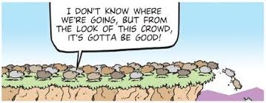
2025 Business as Usual??
unagreaterlincolnshire.org
#bethechange

Slide 5
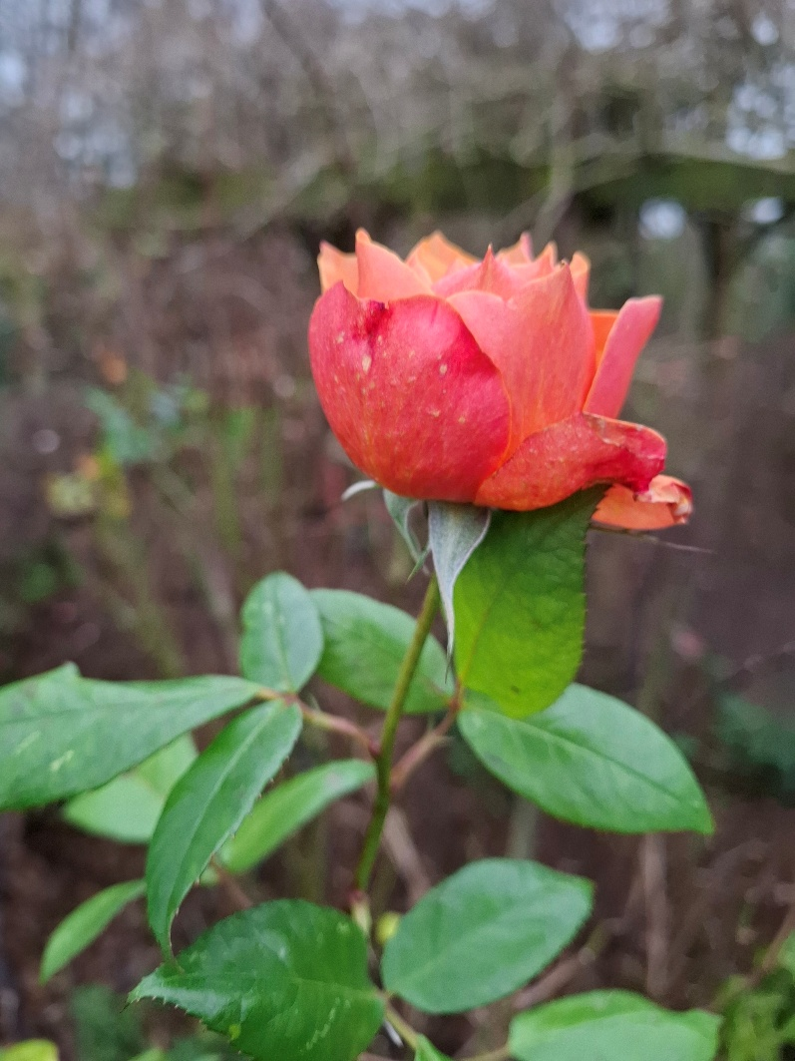
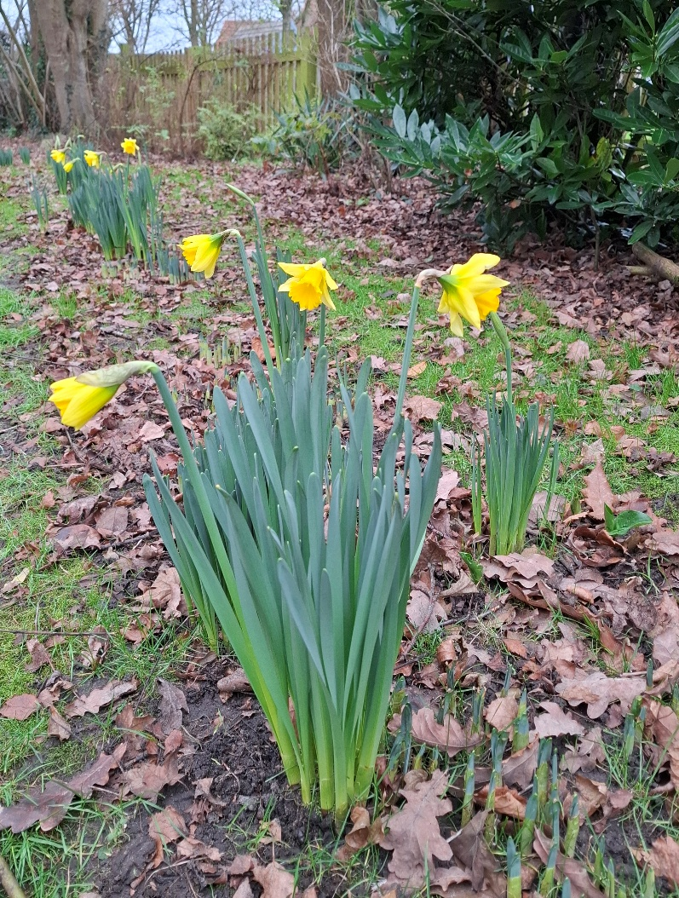
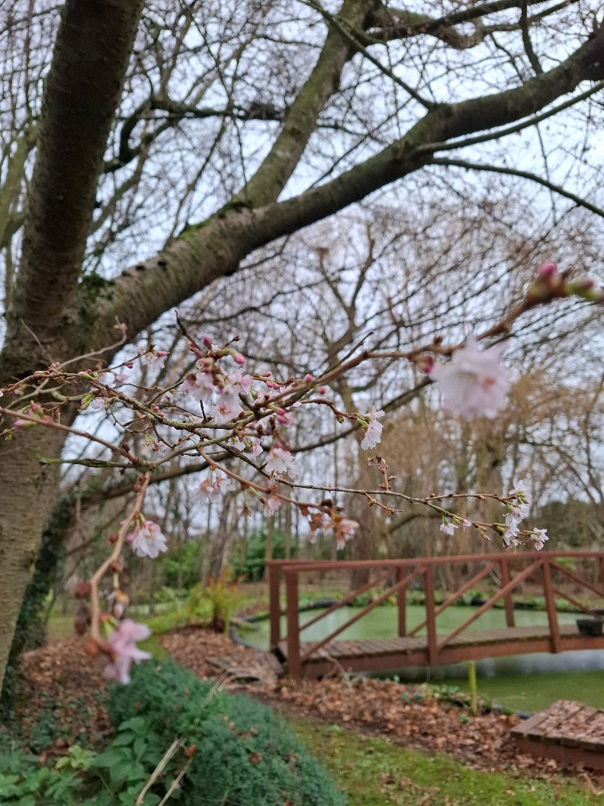
But things are changing! December 25th 2025
unagreaterlincolnshire.org
#bethechange

Slide 6

How are things changing on other 17 goals?
17 UN 2030 Sustainable Development Goals
2025 Update Report
(video)
unagreaterlincolnshire.org
#bethechange

Slide 7
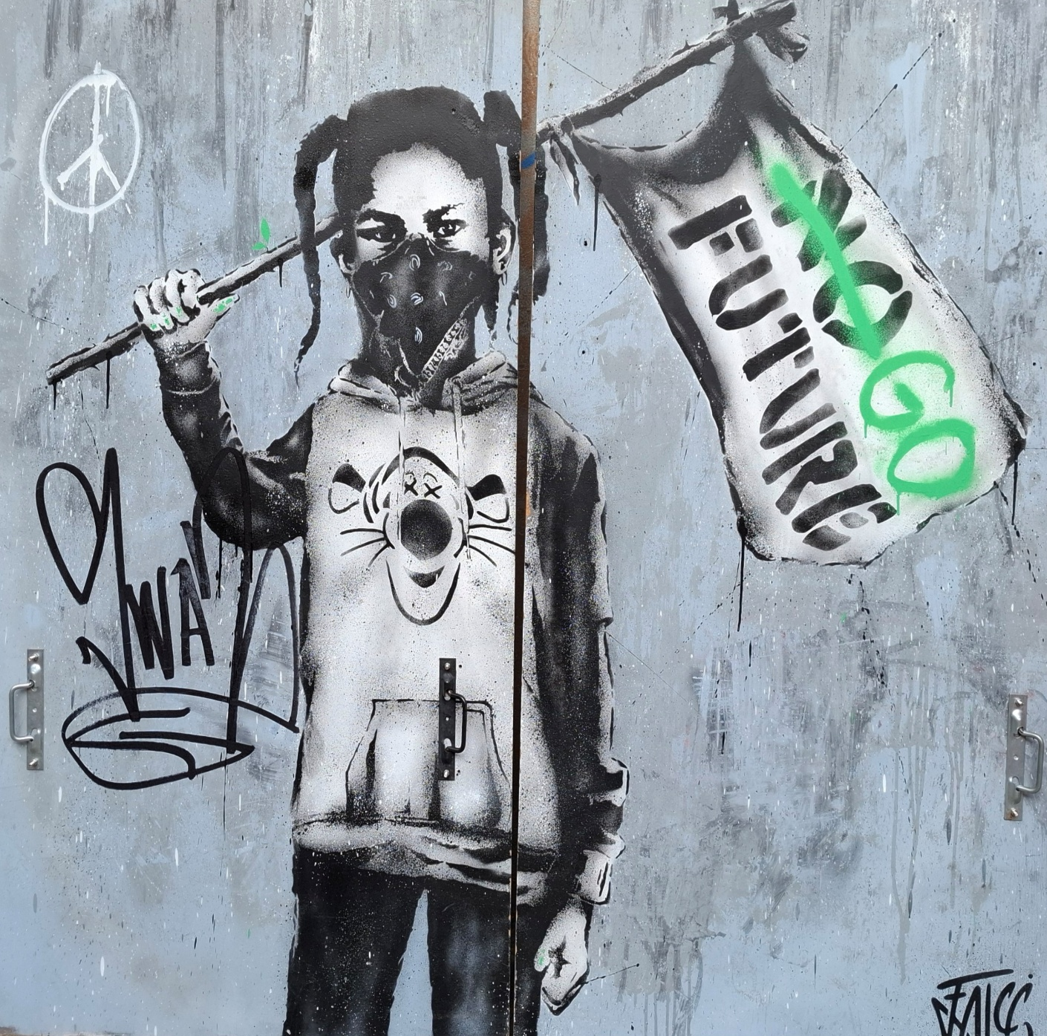
Can we offer a Future and a Hope….
For all living things?
Graffiti in Annecy
Sept 2025
unagreaterlincolnshire.org
#bethechange

Slide 8
UPDATE
  UNA GL Activities and engagement examples
  Locally
  Greenpower Education – Students and Electric Racing Cars at Blyton
  https://www.youtube.com/watch?v=_1DqHmHqYaE
  Internationally
  Costa Rica – an example of sustainable community development using eco tourism as a driver
  https://www.youtube.com/watch?v=NzL6CiO-uIU
unagreaterlincolnshire.org
#bethechange

Slide 9
Local, National and International Changes
2025 to 2026
Greater Lincolnshire a new authority
  Climate Emergency Data from Local Government Association: 300 Local Authorities and 67% County Councils
Lincoln Climate Commission
COP 30 November in Belem Brazil
UN Pact for the Future
  5 Chapters and 2 Annexes
    Annex II First time stated accountability for ‘Future Generations’
unagreaterlincolnshire.org
#bethechange

Slide 10
Challenges we all face in Sustainable Development….
Have your say and advise us
Different age groups
Locally, Regionally, Nationally
In activities in Business/Education/Community
unagreaterlincolnshire.org
#bethechange

Slide 11
How we can continue to make a positive difference
  On my own
  With others
  What would help us to work together
unagreaterlincolnshire.org
#bethechange

Slide 12
A call to continued action
Our Background
“if not you then who, if not now then when”
unagreaterlincolnshire.org
#bethechange

Slide 13
Thankyou
unagreaterlincolnshire.org

