Slide 1

Lincolnshire Poacher 2026
United Nations Association
Leadership and Sustainable Development
From me, mine , here , now ... To we, ours, the world, the future
Notes:
Room set up
Chairs
Display area
PPT facility
World map on the wall
Flip cart and stand and pens
Name badges for all on entry
PPT 3 per page - for participants

Slide 2
Introductions
Welcome, who we are, what we do
Domestic arrangements
Background to the programme
Ground rules, hopes and expectations

Slide 3
Sessions
Session | Theme
Session 1 | Global issues and personal engagement
Break
Session 2 | Global Citizenship, Economic Growth and Development
WORKING LUNCH
Session 3 | Developing a workshop for others on Global Issues and Sustainable Development
Break
Session 4 | Producing and sharing workshop ideas

Slide 4
INTRODUCTORY ACTIVITY
LINE UPS
POSITION TAKING
DIALOGUE

Slide 5
Perceptions, Difference and Conflict
How I see the world may differ from others
How do I/WE manage differences?
REG AND RUBY
RESPECT | RESPECT
EMPATHY | UNDERSTANDING
GENIUINENESS | BE
 | YOURSELF

Slide 6
Day 1 Introductions and aims
Aims of the programme
  To develop an awareness of global issues and international development agendas and the current and future impact on all our lives
  To develop an understanding of global citizenship
  To develop knowledge understanding and skills to lead a UN Sustainable Development Workshop

Slide 7

Notes:
The SDGs outline a new and ambitious worldwide effort to reduce poverty and hunger, improve health, enable equality, protect the planet and much more.
EXPLAIN
The largest consultation exercise on the planet, involving ……. Countries, State leaders, governments, NGOs, international organisations, civic society, The Voices of the Poor
Notably took on board the CAP - Common African Position – where African states identified the needs of African people / states
This ensured that peace and security were included, quality education (not just sitting on seats),
The 2030 Agenda for Sustainable Development pledges to leave no one behind.
Leader to next activity - Real progress will be elusive unless all children receive a quality education.

Slide 8
Global Goals
Video Link to “We The People”
https://www.youtube.com/watch?v=RpqVmvMCmp0

Slide 9
Session 1
Global issues and personal engagement
Activity 1– In pairs
  Look at your clothing labels, write the name of the item of clothing and the country it was made on a post – it, then place it on the world map
  Do the same with the type foods you have eaten in recent days
  Do the same for items of electronic equipment/ family car
Notes:
Post it notes
Use world map
Flip chart / pens

Slide 10
Session 1
Global issues and personal engagement
Review the map
What are the themes emerging
Are there any surprises
Can any future implications for your family/community /nation be drawn
Can any future implications be identified for other nations
Notes:
Flip chart and stand and pens

Slide 11
Session 1
Global issues and personal engagement
Activity 2 – in 4’s
  Consider the nature of development across the world – What do you think will be challenges and opportunities for young people over the next 15 years ( to 2040) that will impact on their wellbeing? ( Put each one on a Post-it)
  Place each post –it on one of Political, Economic, Social, Technological, Legal, Environmental boards.
  What can we learn from this activity?
Notes:
Post its
Flip chart paper + blu tac for SLEPT sections

Slide 12
Session 1
Global issues and personal engagement
PESTLE Analysis
What is PESTLE analysis?
What does PESTLE analysis include
PESTLE is an analytical tool used to explore factors that impact on individuals, organisations and communities

Slide 13
Session 1
Global issues and personal engagement
P – Political
  The current and potential influences from political pressures
E - Economic
  The local, national and world economic impact
S - Sociological
  The ways in which changes in society have an impact (including beliefs)
T - Technological
  How existing, new and emerging technology impact
L – Legal
  How local, national and global legislation impacts
E – Environmental & Sustainability
  The impact of our actions on our environment and the impact of a changing environment on us

Slide 14
Session 1
Global issues and personal engagement
Political:
  Government type and stability
  Freedom of the press, rule of law and levels of bureaucracy and corruption
  Regulation and de-regulation trends
  Social and employment legislation
  Tax policy, and trade and tariff controls
  Environmental and consumer-protection legislation
  Likely changes in the national and international political environment
  Conflict issues between nation states and in nations states
Economic:
  Stage of a business cycle
  Current and projected economic growth, inflation and interest rates
  Unemployment and supply of labor
  Labor costs
  Levels of disposable income and income distribution
  Impact of globalisation
  Likely impact of technological or other changes on the economy on costs and prices
  Likely changes in the economic environment – expectations

Slide 15
Session 1
Global issues and personal engagement
Sociological:
  Cultural aspects, health consciousness, population growth rate, age distribution,
  Organizational culture, attitudes to work, management style, staff attitudes
  Education, occupations, earning capacity, living standards
  Ethical issues, diversity, immigration/emigration, ethnic/religious factors
  Media views, law changes affecting social factors, trends, advertisements, publicity
  Demographics: age, gender, race, family size
Technological:
  Maturity of technology, competing technological developments, research funding, technology legislation, new discoveries
  Information technology, internet, global and local communications
  Technology access, licensing, patents, potential innovation, replacement technology/solutions, inventions, research, intellectual property issues, advances in manufacturing
  Transportation, energy uses/sources/fuels, associated/dependent technologies, rates of obsolescence, waste removal/recycling

Slide 16
Session 1
Global issues and personal engagement
Legal:
  Current home market legislation, future legislation
  European/international legislation
  regulatory bodies and processes
  environmental regulations, employment law, consumer protection
  industry-specific regulations, competitive regulations
Environmental and Sustainability Issues:
  Sustainable development
  The effects of Climate change
  Attempts to halt climate change
  Environmental degradation, desertification, deforestation, water and air pollution
  Inequalities – who caused the issue? Who suffers?
  Industrialisation and Urbanisation
  Adaptation and resilience

Slide 17
Session 1
Global issues and personal engagement
Activity 3
On a piece of A4 paper –
Draw a picture of ‘the future’ – as you see it
When finished put on the wall – then its break time!
Notes:
A4 plain paper + pens ( coloured)
Blu tac

Slide 18

Time for a break

Slide 19
Session 2
Global Citizenship, Development and Economic Growth
Activity 1
Review of the future - as we see it!
What does the pictures tell us about our view of our future together
How do our (individual and collective) views of the future affect our current behaviours as individuals, families, communities, businesses, nation states
Notes:
Flip chart for feedback

Slide 20
Session 2
Global Citizenship, Development and Economic Growth
Where do I belong?
To whom am I accountable?
Who is my neighbour?
Where is the limit of my engagement in international development?
Who is responsible for development and international development?
What decisions as consumer, producer and citizen do you make on a daily basis that has an impact on your ‘neighbour’

Slide 21
Session 2 Global Citizenship, Development and Economic Growth
What is it? What is measured?
Where does it take place?
How does it come about?
When does it rise /fall?
Who benefits, loses?
Why is it seen politically as important?

Slide 22

Session 2 Global Citizenship, Development and Economic Growth
Economic Growth
An increase in the
amount of goods and services produced
in an economy –
national or
International
Measured in money terms
Trading Economics Data
World output of goods
and services

Slide 23
Session 2 Global Citizenship, Development and Economic Growth
Growth influenced by:
People
( Labour)
Raw Materials
(Land)
Machinery
( capital)
Managers
(Business owners –
private/government)
World output of goods
and services

Slide 24
Session 2 Global Citizenship, Development and Economic Growth
World output of goods
and services
Who benefits from
economic growth
Those that are part of
the production process
via incomes, (wages,
rent, interest, profits) &
those that gain benefits
from public services, or
charity.

Slide 25
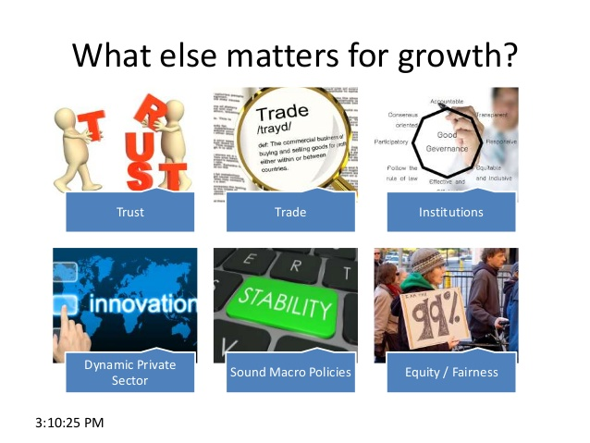
Session 2 Global Citizenship, Development and Economic Growth

Slide 26
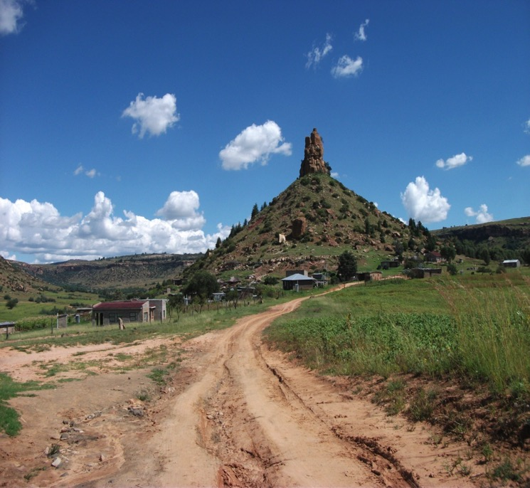
Session 2
Global Citizenship, Development and Economic Growth
And I said to Phapama
Would you have a car
And drive it to work for a mile
Oh yes I would – she replied
And I said –
The roads are so bumpy
Would you want roads flat and tarred
Oh yes – I would like that of course
And I said-
Would you like wide roads with white lines
And footpaths so your children are safe
That’s just what we want she replied
And I said-
Would you drive fast on flat roads
So you get to work in one minute
Exactly she replied
And I said-
By the school with cars that are fast
It would not be safe to cross
She replied-
Then we will need speed bumps of course..
ONE MILE TO SCHOOL

Slide 27
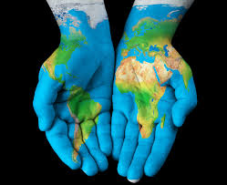
Session 2 Global Citizenship, Development and Economic Growth
Question ...
Is Economic Growth the same as Development?

Slide 28
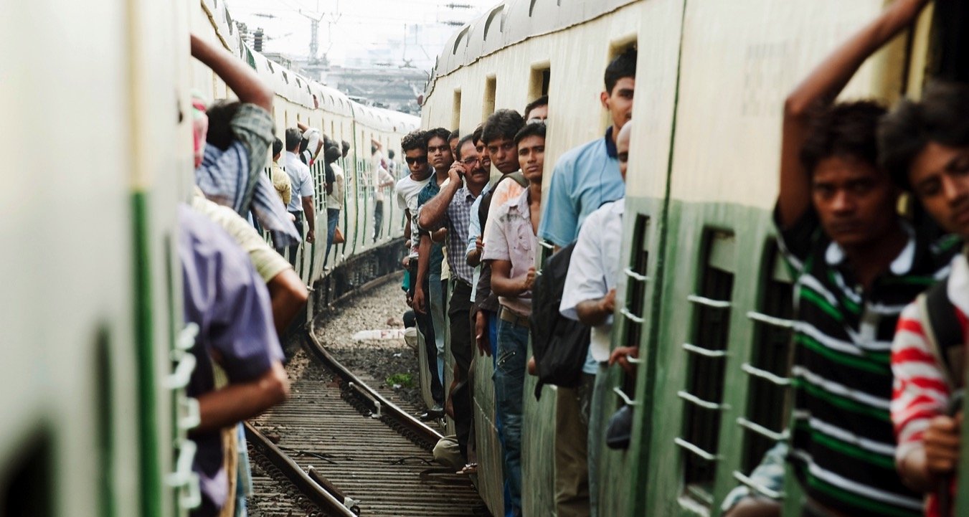
Poverty, population, rural development….
Session 2

Slide 29
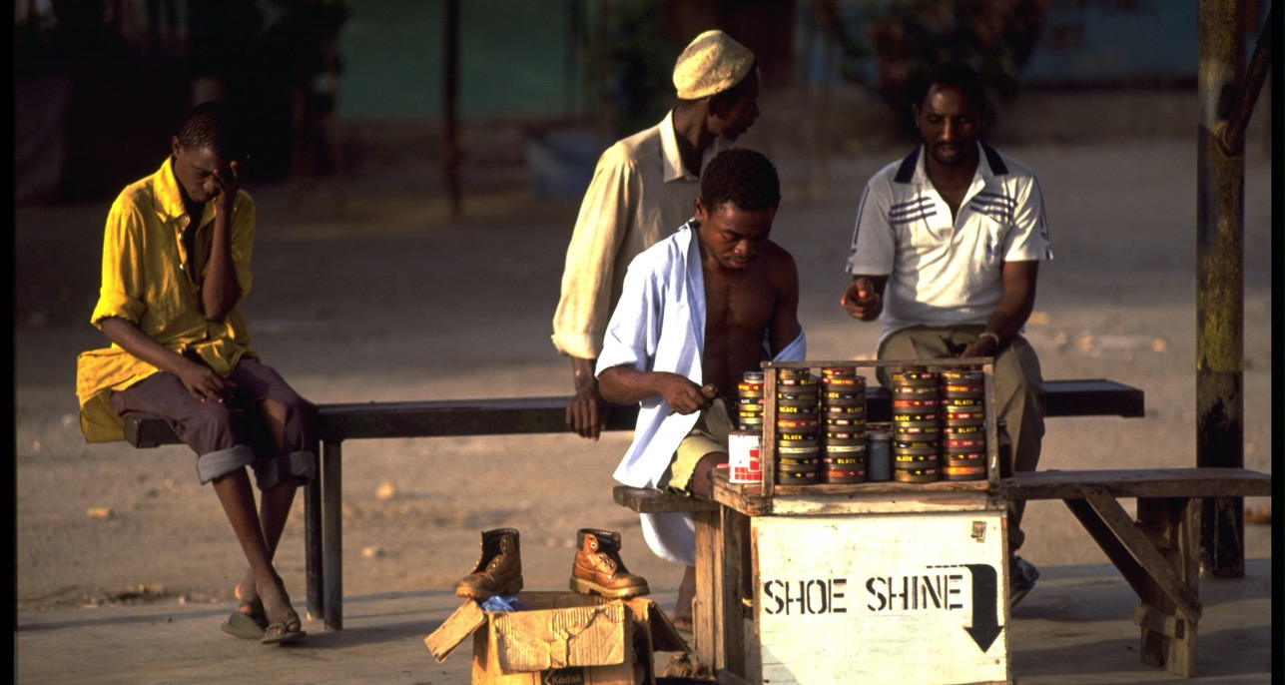
Livelihoods, globalisation, conflict….
Session 2

Slide 30
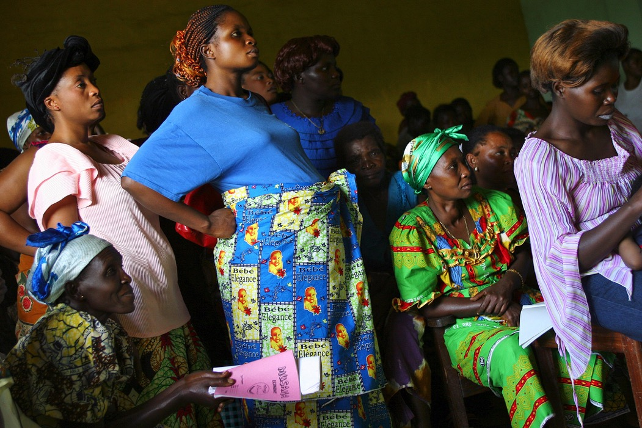
Health, gender, rights, services…
Session 2

Slide 31
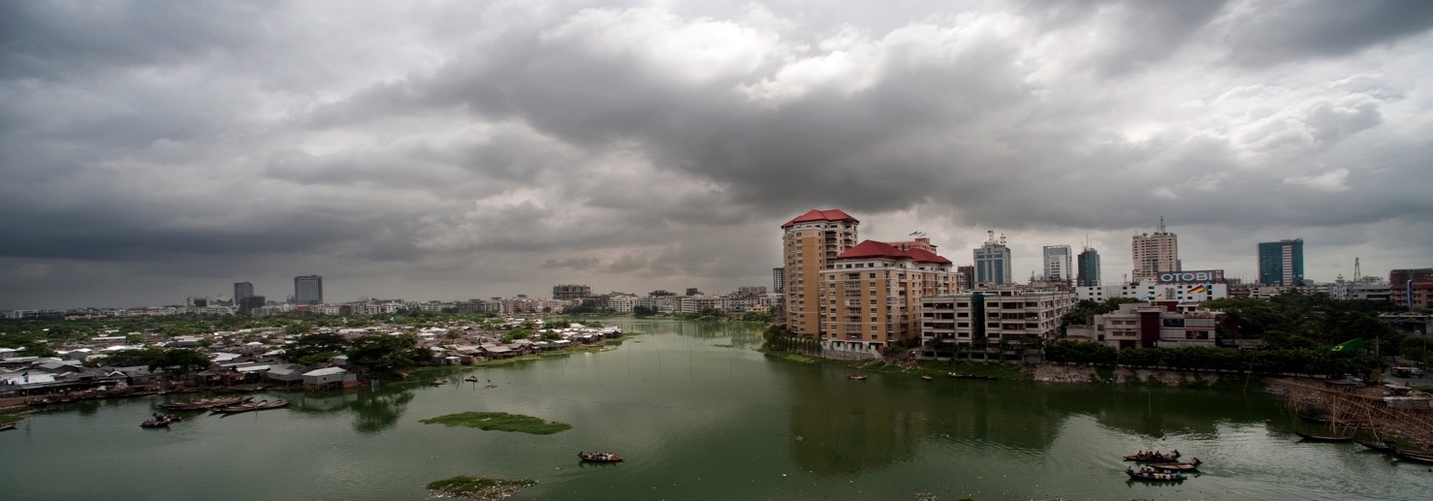
Urbanisation, environment, and resources…
Session 2

Slide 32
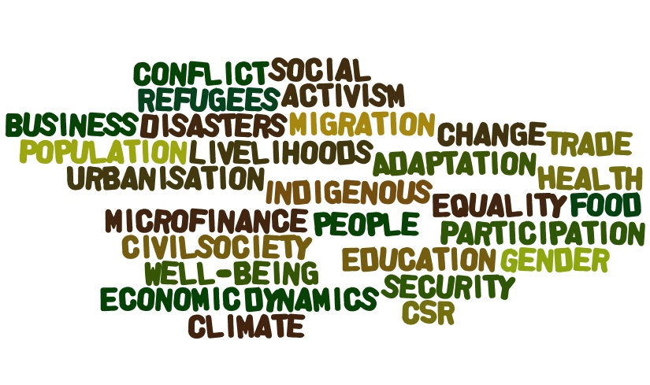
Session 2
What do we mean by ‘International Development’?

Slide 33
Time for Lunch

Slide 34
Developing a workshop for Scouts/Schools/ Community Groups
Session 3
Where is the audience now in knowledge/understanding/skills and attitudes about Sustainable Development?
What will you include in your workshop? Information/activities etc
How will you present the workshop?
What are the challenges you will face, and how you will overcome them in presenting a workshop?
How will you know if the workshop was successful?
Notes:
The emergence of development studies as an academic discipline in the second half of the twentieth century is in large part due to increasing concern about economic prospects for the third world after decolonisation.
In the immediate post-war period, development economics, a branch of economics, arose out of previous studies in colonial economics. By the 1960s, an increasing number of development economists felt that economics alone could not fully address issues such as political effectiveness and educational provision as we have seen earlier in this presentation.
Development studies arose as a result of this, initially aiming to integrate ideas of politics and economics. Since then, it has become an increasingly inter- and multi-disciplinary subject, encompassing a variety of social scientific fields.

Slide 35
Market research
Session 3
You have 30 minutes to go and collect information from fellow scouts about what..
1 They know about Sustainable Development
2 What they think their parents/adults know about sustainable development
3What their local community knows about sustainable development

Slide 36
Session 3
Force field analysis...as easy as 1,2,3!
1 List ‘things’ that positively promote the outcome | 3 List ‘What intervention needs to be done, could be done’ to accentuate the positive or eliminate the negative | 2 List ‘things’ that negatively prevent the outcome

Slide 37
Develop the workshop
Session 3
In Groups start to put together a workshop that last for about 30 Mins about Sustainable Development and the UN 2030 Sustainable Development Goals
Consider the target audience
Resources you will need
Notes:
Why is ‘development’ an important concern?
To give but one example, there are over 900million hungry people in the world and hunger is related to poverty and economic inequality.
This is why traditionally ‘development’ is considered in terms of a nations economic growth and the better living conditions that are assumed to be related to it.
However because there is no direct correlation between a nations wealth and the poverty status of it citizens, we now consider it essential to broaden this concept by looking beyond the rise and fall of incomes.
The term ‘human’ development refers to the factors that help enlarge people choices to be and do what they want in life.
This focus on people choices centres around building their capabilities. The most basic human capabilities are
To lead long and healthy lives
To be knowledgeable (educated)
To have access to resources and social services needed for a decent standard of living
To be able to participate in the life of the community.
Without these fundamental attributes many opportunities in life remain unattainable.
EXAMPLE
An abstract illustration of human capability is the usefulness of a bicycle.
A bike is a resource, a mode of transportation.
If the person who owns the bike is unable to ride it, due to lack of knowledge or ill-health then the bike becomes useless as a resource.
If, however, a person who owns the bike can ride it, he then has the CAPABILITY to riding to the local market, visit his friends and to therefore broaden his choices and opportunities.
Therefore here are six BASIC PILLARS to human development that are considered beyond the more immediate concern of the accumulation of commodities and financial wealth. These are:
EQUITY: the idea of fairness for every person, between men and women, and that each person has the right to an education and health care
SUSTAINABILITY: is the view that we all the right to earn a living that can sustain out lives and have access to a more even distribution of goods
PRODUCTIVITY: refers to the full participation of people in the process of income generation
EMPOWERMENT is the freedom of the people to influence development and the decisions that affect their lives
COOPERATION : stipulates participation and belonging to communities and groups as a source of social meaning
SECURITY offer people development opportunities freely and with confidences that they do not disappear in the future.

Slide 38
Time for a break

Slide 39
Session 4
Sharing your ideas
Learning from others
Notes:
Roll of lining paper
Pens

Slide 40
Session 4 – My Future
Personal Development and Empowerment
Personal Development
  'An individual is empowered to become self, socially and environmentally aware, conversant with all opportunities available to them to lead a fulfilled life, and skilled to make decisions, progress and manage transitions on their journey'.
  From me mine here now to we ours the world the future.
  Freedom as development.
Notes:
Personal inventory sheet
Pens

Slide 41
Personal Reference Inventory for 'functioning individuals‘ 1 - me and others
Independence and Interdependence - Self aware - knowing self
I know my culture and its importance to me in my life and living
I know my values and their importance in my life and living
I have a good understanding of the way the world operates socially, politically and economically
I know that my level of knowledge is sufficient to fully engage in the wider world
I know that my skill level is appropriate and sufficient to fully engage in a wider world
Justice - Socially and environmentally aware
I know and understand the development issues in my locality
I know and understand the development issues in my region
I know and understand the development issues in my continent
I know and understand the development issues in my world
I know and understand how my attitudes and behaviours impact on others and the environment

Slide 42
Personal Reference Inventory for 'functioning individuals‘ 2 – understanding and skills
Freedom - Functioning as part of an international community
I know and understand all my opportunities for work and earning a living
I know and understand all my opportunities for democratic engagement
I know and understand all my opportunities for play and engaging culturally with others
I know and understand all my opportunities for rest, relaxation and creativity
Leadership and Management - Decision making skills
My literacy and language skills are sufficient for international leadership roles
My numeracy skills are sufficient for international leadership roles
My legal understanding is sufficient for international leadership roles
My understanding of economics and business is sufficient for international leadership roles
My political understanding is sufficient for international leadership roles
My understanding of technology is sufficient for international leadership roles
Leadership and Management - Progression and managing transitions
I can manage transition to an adult role in an internationally connected world
In can manage and maintain effective relationships with others individually and groups
I have the ability to be resilient in times of adversity
I can freely engage with others in celebrating progress and achievement

Slide 43
Conclusions

Slide 44
Internet links
Human Development Index - map ( UN)
http://www.globalpartnership.org/blog/17-ways-education-influences-new-17-global-goals
https://www.unagreaterlincolnshire.org/

Slide 45
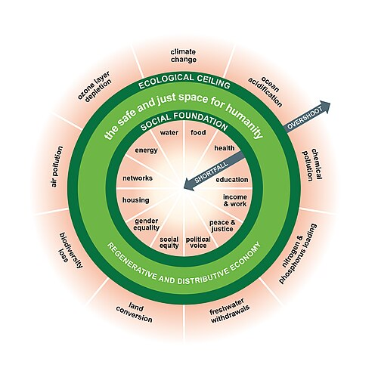
Doughnut Economics

Slide 46
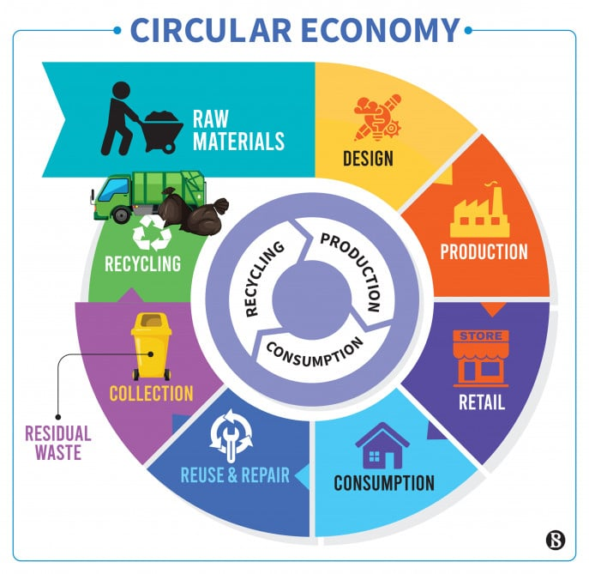
CIRCULAR ECONOMY

