Slide 1
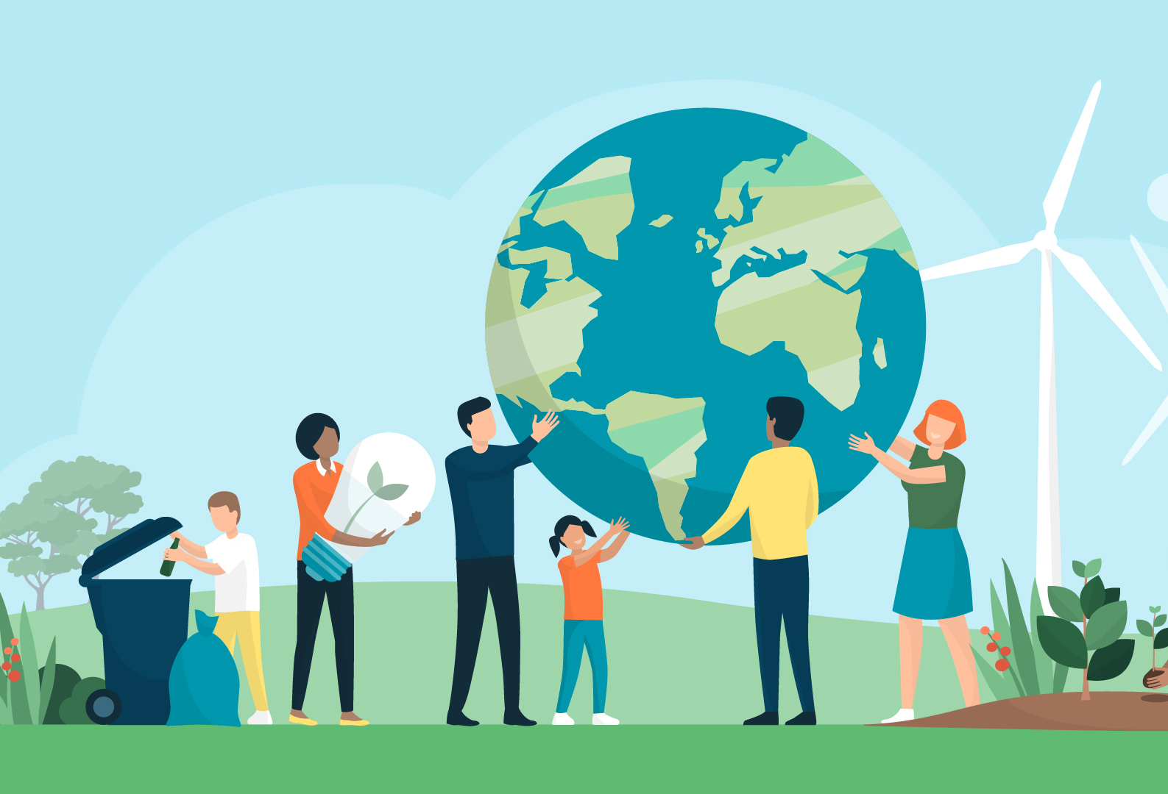

UNA Greater Lincolnshire
Going Bananas for STEM, Climate Change and Sustainability
unagreaterlincolnshire.org
#bethechange

Slide 2

Introduction UNA Greater Lincolnshire
Our Background : A Call to action
“if not you then who, if not now then when”
New thinking and action on sustainable development
unagreaterlincolnshire.org
#bethechange

Slide 3
Going Bananas for STEM, Climate Change, and Sustainability
Students will be able to:
Identify STEM careers in the Banana journey
Understand links between Bananas and Climate Change
Explore links between ‘Bananas’ and the UN 2030 Sustainable Development Goals

Slide 4
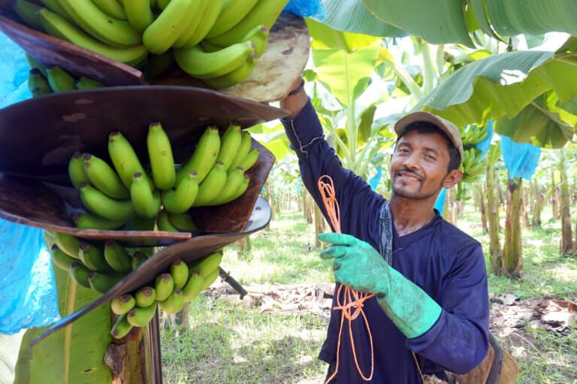
Banana Plantation
It’s a herb plant not a Tree!

Slide 5
Bananas
Over 100 billion bananas are eaten every year in the world
Making them the 4th most popular agricultural product.
Banana plants thrive in tropical regions where the average temperature is 80° F (27° C) and the yearly rainfall is between 78 and 98 inches.
Most bananas exported are grown within 30 degrees either side of the equator.
The plants need rich, dark and fertile soils with steady moisture in the air and ground and good drainage.

Slide 6
The Banana Supply Chain
From picking green bananas in the tropics to seeing them yellow in a UK supermarket takes roughly 2 to 4 weeks.
In exploring the supply chain from producer to the local supermarket we will discover a range of STEM careers and explore what makes a sustainable ‘Green Career’
unagreaterlincolnshire.org
#bethechange

Slide 7
From a tropical plantation to your house
Using the roll of lining paper, start at one end with a drawing of a Banana Plant
At the other end a house you live in in the UK
Along the line of paper draw all the activities needed and list the jobs involved in getting the banana from the tree in the tropics to the house in the UK

Slide 8
What is STEM career and a ‘Green Job/Career’
A STEM Career is any work that involves Science, Technology, Engineering and Maths
A Green Career is any job that contributes to protecting, restoring, or improving the Environment, tackling Climate Change, and promoting Sustainability
How many of the jobs you have identified could include sustainability thinking and be linked as Green Careers

Slide 9
Bananas and the Climate Challenge
New research from the University of Exeter, published in Nature Food, has found it will be economically unsustainable by 2080 for many areas across Latin America and the Caribbean to continue growing bananas for export, because of rising temperatures caused by climate change.
Bananas are a key export crop worth $11 billion (£8.9 billion) annually and are crucial for the economies of many countries.
Yet in just over half a century, 60 per cent of the regions currently producing bananas will struggle to grow the fruit unless there are urgent interventions to tackle climate change.

Slide 10
What is Sustainable Development
Sustainable development is a global approach to growth.
It balances present needs with future well-being, focusing on integrating economic prosperity, social inclusion, and environmental protection (the three pillars) to ensure lasting progress for all people and the planet.
The 17 UN 2030 Sustainable Development Goals identify areas for action.

Slide 11
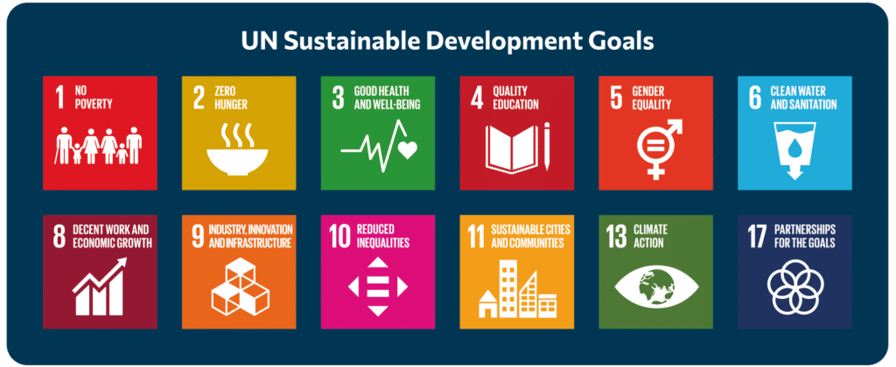

Slide 12
UN 2030 17 Sustainable Development Goals
Launched in 2015 with many supporters you may recognise.
‘We The People Video’
Web Links for background research
https://www.bananalink.org.uk/all-about-bananas/
https://news.exeter.ac.uk/faculty-of-health-and-life-sciences/climate-change-threatens-future-of-banana-export-industry/
https://www.fao.org/world-banana-forum/en/
https://sdgs.un.org/goals

Slide 13
Thankyou “If not you then who, if not now then when” New thinking and action needed on sustainable development
unagreaterlincolnshire.org

